Slide 1
Just The Facts
The Federation was chartered in 1979 but the members then had to try electing board members in favor of collective bargaining. It took four cycles (16 yrs) of school boards before a positive vote in 1991.
There are only five school systems in Louisiana with collective bargaining. We are the only one with wall to wall collective bargaining.

Slide 2
New Language Common To All Employees
Remove Article III from all subgroups and add as Article III in Common To All Employees
This is the Just Cause provision that was in each of the 7 groups and is now listed as “common to all employees.”
No more than two (2) representatives shall be present and speak on behalf of an employee at disciplinary conferences without the consent of the principal, supervisor or administrator conducting the conference. By Federation representative is meant any individual, exclusive of legal counsel, allowed by the Federation to represent Federation members and Bargaining Unit employees.
Article XXIV - Considering the possibility that a natural disaster such as hurricane, flood, pandemic of wide-spread infectious disease or other act of God or man could cause widespread destruction to school system property and facilities, make it impossible for employees to perform the duties of their classifications, significantly reduce the student population or significantly and negatively affect the school district’s funding or tax base
Section 25:25 – Working Conditions – School Year 2020-2021
Due to Hurricanes Laura and Zeta it is understood schools were closed for 5 days and there were no additional calendar days due to COVID 19. As a result, the calendar make-up days will be added to the end of the school year. Therefore, the students’ last day will now be May 28, 2021, and Teacher Day will be June 1, 2021.

Slide 3
Section 7:03 – Distribution of Materials
The Federation shall have the right to distribute Federation materials and literature to Bargaining Unit members. Distribution of such materials shall be made only by authorized representatives of the Federation. All materials distributed by the Federation shall bear the name of the Federation. It shall be further provided that such communication shall not include material that are oriented in any manner whatsoever to the candidacy of persons of national, state, or local political office. No competing organization shall be extended this right.
Section 7:07 - Federation Bulletin Boards
The Federation shall have the continued use of bulletin boards currently set aside for Federation use in the employee lounge or common employee work area in each school for the posting of notices and other materials relating to Federation activities. The Federation shall have the right to provide at each new school site, a 3' x 3' bulletin board to be placed in the faculty or employee lounge. The bulletin board shall be identified with the name of the Federation and shall be reserved exclusively for Federation materials. Any authorized representative of the Federation may post materials on the bulletin board. All materials placed on this bulletin board shall bear the name of the Federation. No competing organization will be extended this right. It is further provided that such communication shall not include any materials that are oriented in any manner whatsoever to the candidacy of persons of national, state, or local political office.

Slide 4
ARTICLE XXV – WORKING CONDITIONS
Remove from “Common To All” and add to subgroups with 12-month employees [maintenance, custodial, secretaries, and clerks. This will be added as a new section under Working Conditions Article where it falls in alphabetical order.
Article VI: Federation Rights
7. The Federation must supply the audited financial statement for Health and Welfare Fund each calendar year no later than June 30th.
The sick leave balance of an employee who resigns and is rehired will be reinstated upon the return to work if leave is still available.
Section 12:05 - Special Leave of Absence
e. Such application may be rescinded at any time by giving notice thereof in writing to the Superintendent or designee. Such leave may be rescinded at any time if the Superintendent determines that the employee is working in another School System or in another job if the first day of employment of that job is post the leave request date or if rescission is in the best interest of the St. Tammany School System for any other reason.
f. All St. Tammany Parish School System employees must be employed for one year to be eligible for leave.
g. Leave requests Requests for leave without pay for elective surgery or elective procedures not deemed as a medical emergency by a physician shall not be granted during the school year.

Slide 5
Teachers and Certificated Employees
Section 10:18 - Planning Time
Elementary teachers shall have at least 150 minutes of planning time per week
provided by art, library, music, guidance, ancillary curriculum and physical education
periods at each school. The phrase "elementary teachers" means regular education
teachers of grades PreK-6.
g] Planning time shall appropriately include academic study preparation of lesson plans and parent conferences. Parent conferences shall not be required during planning time. Conferences which require the presence of the principal shall be scheduled at a time convenient for all concerned. Planning time shall be free of duty.
The planning and preparation time shall be used judiciously and
appropriately and may include collaborative planning, grade
level/departmental meetings, professional development and study groups,
provided such shall occur no more than twice each week.

Slide 6
Section 4:01Section 4:01 – In General
Unless and until modified in accordance with the provisions of this Article, the St. Tammany Parish School Board evaluation plan in force beginning with the 2011-12 school year will remain in effect.
Section 4:03 – Evaluation Plan Inservice
Within two (2) weeks after the beginning of each school year, or when information becomes available from the State, the building principal or designated administrator shall conduct a workshop so as to fully inform each employee regarding evaluation procedures, standards and the instruments to be used. Attendance at evaluation plan workshops shall be voluntary.

Slide 7
Section 5:07 - Lesson Plans
The Board shall provide roll books to all employees
Section 5:09 - Roll Books
Employees linked to the electronic student information system shall maintain their roll books using the electronic student information system, or any other electronic system approved by the Superintendent. Employees not linked to the electronic student information system shall maintain the standard roll book provided by the board.
Section 10:16 - Itinerant Teachers/Miscellaneous Provisions
The quarterly grade is to be a cooperative effort between the classroom teacher and the itinerant elementary physical education, music, and art teacher.
Section 5:02 - Acceptance of New Students
a. When a new student is enrolled in a school, prompt notice shall be provided to the teacher[s] scheduled to receive such each new student as soon as possible.

Slide 8
Appendix
Salary Supplements – Coaches Only
Junior High School
a. Athletic directors 3% 5%
b. Sport Head Coach Assistant Coach
Football 6% 4%
Basketball 6% 4%
Baseball 3% 0%
Softball 3% 0%
Any person who coaches the following sports will receive 3%.
Volleyball Dance Softball Track
Soccer Cheerleading Baseball
d. The maximum percentage one junior high coach can receive is 15% 17%

Slide 9
All Subgroups of Non-Certificated Except Bus Drivers Owner /Operators
Voluntary Transfers: Employees shall remain in their current site for two years prior to being eligible to request a transfer, however, if the time spent in the current position at the current site is less than two years, but the position the employee is requesting would provide a salary increase, then the employee may request the transfer to a new position. Once the employee accepts the new position, the two year requirement to be eligible to transfer shall commence once again.
Custodial Employees
Section 9:04 – Equipment Needed Employee Uniforms
The Board shall provide each employee with materials, supplies and equipment with which to perform his duties.
The Board shall provide each employee with materials, supplies and equipment with which perform his duties, including new uniform shirts every year which will be required to be worn while at work. The employee may purchase additional shirts at board cost.

Slide 10
Section 9:13 – Workday, Workweek and Fair Labor Standards Compliance (FLSA)
Full-time custodial employees shall work seven (7) or eight (8) hours per day, exclusive of a duty- free lunch of at least 30 minutes, but inclusive of two (2) 15-minute breaks. Part-time custodial employees shall work the number of hours. The total numbers each day, less than seven (7), established by the principal or building supervisor in consultation with the Supervisor of Maintenance and Custodial Services. Part-time custodians who work at least six (6) hours per day shall be given a lunch break of at least 30 minutes, exclusive of their six (6) work hours, but inclusive of two (2) 15-minute breaks. Custodians who work less than six (6) hours per day shall receive one (1) 15-minute break, inclusive of work time.
Custodial employees shall be scheduled for a seven [7] or eight [8] hour day, and a duty-free lunch, but inclusive of two [2] 15 minutes breaks. Part-time custodial employees shall work each day, less than seven (7) hours, established by the principal or building supervisor of Maintenance and Custodial Services. Part-time custodians who work at least six [6] hours shall be given at least a 30 minute duty-free lunch exclusive of their 6 hours of work, but inclusive of their two [2] 15 minute breaks. Custodians who work less than 6 hours per day shall receive one [1] 15 minute break, inclusive of work time.
The total number of regular hours worked by custodial employees shall not exceed 40 hours in a work week without the express permission of the Superintendent or designee. Any employee who believes or asserts that he/she is being required to work in excess of 40 hours in a single week shall report this directly to his/her principal or building supervisor or Supervisor of Maintenance and Custodial Service or to Human Resources

Slide 11
Custodial Employees Continued
In order to assure FSLA compliance, custodial employees shall be required to sign in and sign out of work either by electronic or mechanical means established by the Board. Signing in and out in this manner shall also apply in cases where custodial employees receive a lunch break. Signing in and out shall not be required when taking 15 minute break.
Any hours worked by a custodial employee in excess of 40 hours in a work week shall be compensated in accordance with FSLA by paying the employee 1.5 times his/her regular rate or by alternately giving the employee compensatory time-off equal to 1.5 hours for each hour worked in excess of 40 hours. The Superintendent shall decide whether to compensate overtime with extra pay or compensatory time.
The parties understand and agree that the salary paid to full-time custodial staff is based on a 40 hour work week. Although they will be scheduled for a 35 hour week, there may times Superintendent that they remain at work longer than his/her scheduled hours for a given day, in which case additional compensation need not be paid in order to comply with the FLSA.

Slide 12
Paraprofessionals
Section 9:15 - Reporting/Departing School
Considering that paraprofessionals are responsible, along with certificated employees, for assisting in the orderly opening and dismissal of school and for insuring that students on campus are monitored and attended, paraprofessionals shall sign in and be required to sign in an out of work by electronic or mechanical means as established by the board and report for duty at least five (5) minutes prior to the start of the school day but in no case more than 15 minutes prior thereto. They shall remain at the schools to which they are assigned for a period of ten (10) minutes following the dismissal bell at which time they shall sign out. The only exception to these general rules of reporting and departing will be for paraprofessionals who are scheduled for non-classroom duty and who shall report and depart, sign in and sign out, in accordance with that schedule.
Section 8:01 – Involuntary Transfers
e. ………..Employees interested in returning to their former schools or worksites shall notify the Department of Human Resources. If returned, building level seniority will be restored.

Slide 13
Section 9:10 - Paraprofessional Responsibilities/Teacher Substitutes
a. In the event a substitute is not procured and the paraprofessional must remain in that classroom for a half day or more as a teacher, the paraprofessional shall receive a differential pay flat stiped of ten [10] dollars per hour in addition to their normal pay for each full hour worked.

Slide 14
Food Service Employees
Section 9:03 – Dress Code
Employees will be paid a uniform clothing allowance of $75.00 each contract year. The Board will provide new uniform shirts for food service employees every year which must be worn at work. Additional shirts can be purchased at board cost.
Clothing Uniform shall consist of uniform shirts provided by the school system,
solid slacks or skirts, enclosed slip resistant shoes and effective hair restraint. At each worksite, the employees may determine by majority vote to wear a color or style of clothing shirt different from solid white the board approved uniform shirt. However, uniformity of dress must be maintained among the group and the clothing must be is tasteful and modest. Any employee who does not wish to wear the color or style of dress on any given day worn by the group may wear a solid white shirt or the Board approved uniform shirt and solid slacks or skirt. Clothing selected for work may must be of the type and style that is appropriate, and professional; however no clothing considered unsafe and safe for Food Service work may not be worn at any time. Shorts are not allowed.

Slide 15
Bus Owners/Operators and Attendants
Section 8:02 - Voluntary Transfers
c. All known vacant routes and new routes shall be posted on the Federation bulletin board located in each school. Consolidated, reduced or extended routes shall not be considered new routes. A copy of the posting shall also be sent to the Federation office. Consolidated, reduced or extended routes shall not be considered new routes.
d. The posting shall indicate that all tenured bus owners/operators or bus attendants who have any interest whatsoever in transferring from their existing route to the newly created route or to the route then- known to be vacant or to any route that may become vacant as a result of owners/operators or bus attendants transferring must file an application containing such information as may be required by the Director of Transportation by the deadline established for applying. Vacancy postings shall provide a minimum of seven (7) workdays prior to the deadline for application. Any owner/operator or bus attendant not applying within this established deadline will not be considered for transfer to the newly created or vacant route, or to any route(s) that may become vacant in the transfer process. Application forms will be made available at each worksite. Posting of new and vacant positions shall include approximate mileage.

Slide 16
Transportation Transfer Fair will be conducted annually for all Bus Drivers interested in vacant routes. All transfers will be effective for the following year. Bus Drivers, Temporary Drivers, and Itinerant Drivers are eligible to participate in the Transfer Fair. Day-to-day substitutes are not eligible to participate. This voluntary transfer process will begin in April of every calendar year and will continue until all routes are filled or until a designated date in June not to extend beyond the last work day of June for that calendar year.
Vacant routes not filled as a result of the Transfer Fair will be filled by an approved applicant. Routes that become available after the final round of the Transfer Fair will be considered temporary and filled with a Substitute Driver, Temporary Driver, or an Itinerant Driver.
Information relative to the timeline for participation, the required form, and the current vacancy list will be made available to all eligible employees. Vacancy postings shall provide a minimum of seven [7] workdays prior to the deadline for application. Any Driver not applying within this established deadline will not be considered for transfer to the newly created or vacant route, or to any route [s] that may become vacant in the transfer process.
Eligible employees interested in a vacant route must submit a transfer request form to the Human Resources Department by 4:30 p.m. on or before the day of each deadline outlined in a timeline. A transfer request form must be completed for each route of interest. The forms are fillable and must be sent to the Human Resources Department via the employee’s School Board email.
e. Routes will be awarded per the current Louisiana Revised Statutes.
3. Employees awarded a vacant route will be notified by the Human Resources Department.

Slide 17
A Transportation Transfer Fair will be held every year beginning in April and ending June 30th. Routes available for the upcoming school year will be posted in April via a Vacancy List. The Vacancy List along with a timeline to apply for each round of the Transfer Fair will be posted on the St. Tammany Parish School Board website.
Eligible employees interested in transferring will submit a Transfer Request form to the Human Resources Department by the deadline established for each round of the Transfer Fair. Late forms will not be accepted.
Routes will be awarded according to the current Louisiana Revised Statute. The transfer process will continue until all routes are filled or until June 30th. All routes accepted by June 30th are binding for the upcoming school year.
Vacancies created as a result of the last round of transfers or due to the resignation or retirement of an employee after June 30th will be considered temporary. These vacancies will be filled with temporary employees designated by the Director of Transportation.

Slide 18
St. Tammany School Board General Fund Budget
Ending balance for 2019-2020 FY - $122.5 million.
$20.9 million committed to bond rating leaving a balance of $101.6 million
School fund policy committing 19% of current fiscal expenditure and transfers – contingency fund
Business Affairs Director recommends for fund balance is 3 months of expenses in case of natural disaster that could impact revenues
School Board requires $35 to $40 million per month to cover expenses.
The LADOE is the Board’s oversight and requires explanation when a board dips into fund balance
Current year budget is $432.7 million – very uncertain due to COVID 19
Areas of Concern for FY 2020-2021
Student count for October 1 reflect decrease of 1,200 students which is equivalent to approximate MFP loss of $7 million.
COVID 19 costs incurred by board were:
$7.4 million in grant funds will not cover pandemic costs.
Sales tax has been steady, but threat of shutdown would impact those returns.
Hurricane season financial impact hasn’t been finalized.
State budget is in flux due to COVID 19

Slide 19
Compensation Packet
Three part package – through much discussion and number crunching, your bargaining team and the School Board’s bargaining team devised a three part compensation package.
The beauty of this package is that salary re-openers will be in the Spring of each year of the contract with the exception of 2020-2021 school year.

Slide 20
Part I of Compensation Package is a “thank you” for your hard work during the pandemic.
A one-time stipend of: $1,000 for all employees employed before December 1, 2020.
Employees who are 12-month employees will receive more than $1,000.
This $1,000 stipend will be paid in your December 18, 2020 pay check

Slide 21
Part 2 of the Compensation Package is:
A step replacement stipend in the amount of $1,000 for certificated employees and
$700 for non-certificated employees
Employees who are 12-month certificated employees will receive more than $1,000. And 12-month non-certificated employees will receive more than $700.
These $1,000 and $700 stipend will be paid in your December 18, 2020 pay check.
Total of Part 1 and Part 2 will be:
$2,000 for certificated employees
$1,700 for non-certificated employees

Slide 22
Part 3 of the Compensation Package is:
A] For July 2021-2022, the Board will guarantee a one pay level [step] increase of $500 for certificated employees and $350 for non-certificated employees. A second pay level increase of $500 for certificated and $350 for non-certificated employees will be granted based on the following criteria:
1. enrollment as of February 1, 2021 is equal to or more than February 2, 2020 enrollment.
2. No major reduction in projected ad valorem taxes, sales taxes, or MFP state funding for FY 2021-2022. A 10% or more reduction in any of these revenues would be considered a major reduction.
3. Projected costs of the continuation of COVID 19 pandemic after federal and state funding is causing a deficit in the General Fund budget before adding in this second level increase for employees.
This Photo by Unknown Author is licensed under CC BY-SA

Slide 23
Part 4 of the Compensation Package is:
The length of the contract is 4 years. Salary re-openers will occur in March/April of each year of the contract beginning in Spring 2022. Only salary issues will be bargained.
The compensation package is worth approximately $15 million.

Slide 24
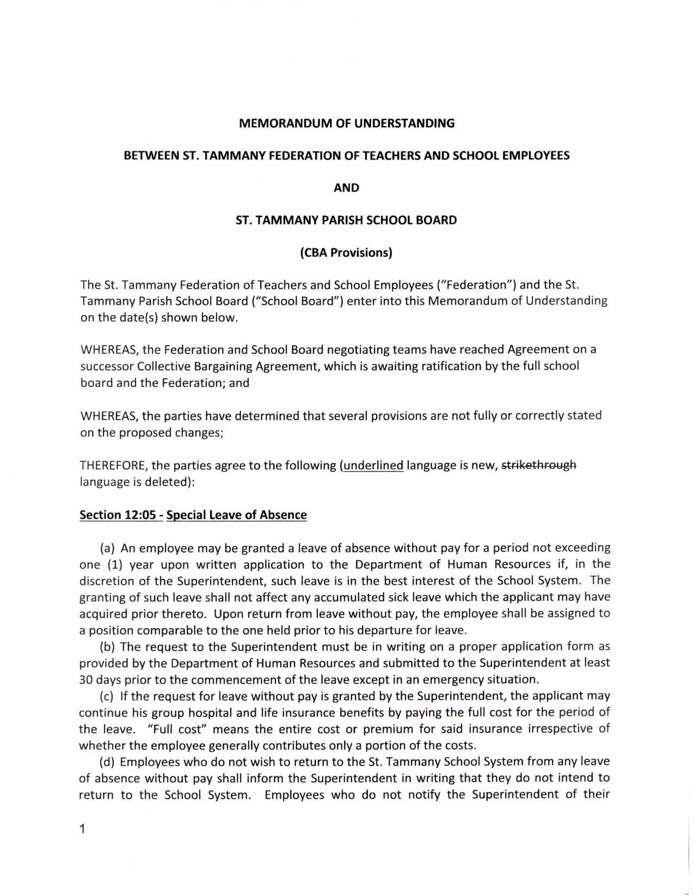

Slide 25
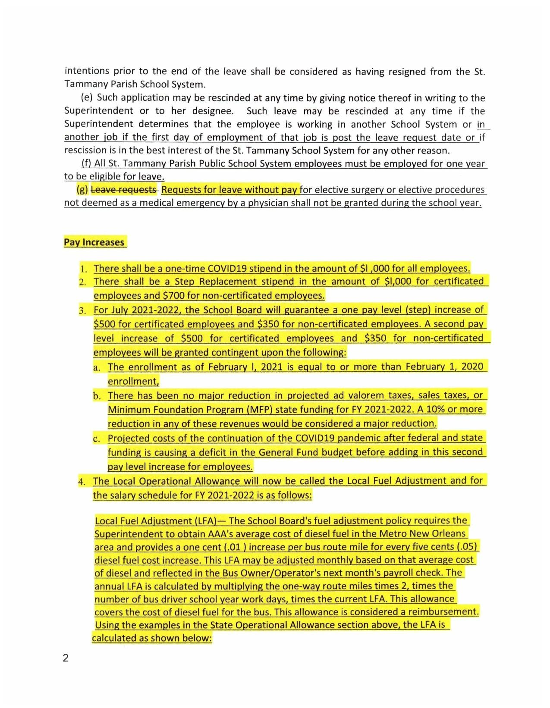

Slide 26
