Slide 1
Student Violence Against Staff Survey Results
St. Tammany Federation of Teachers and School Employees

Slide 2
Survey Details

Slide 3
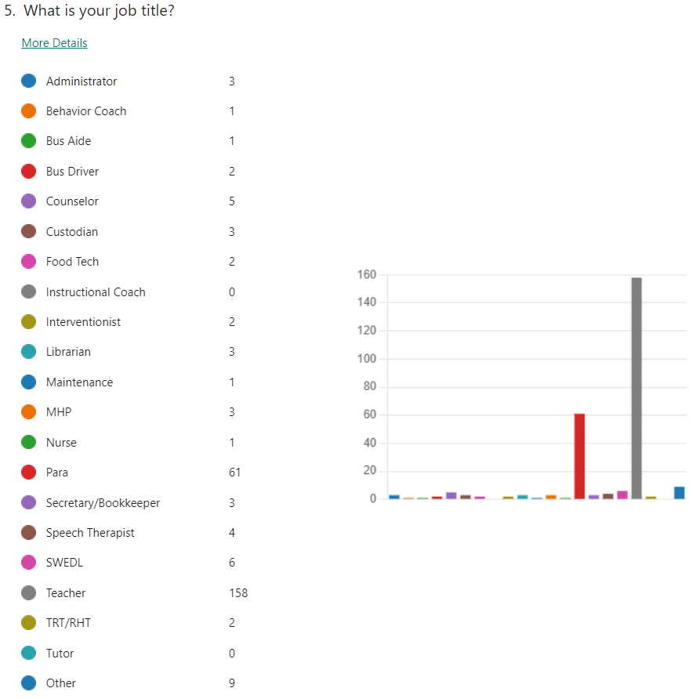
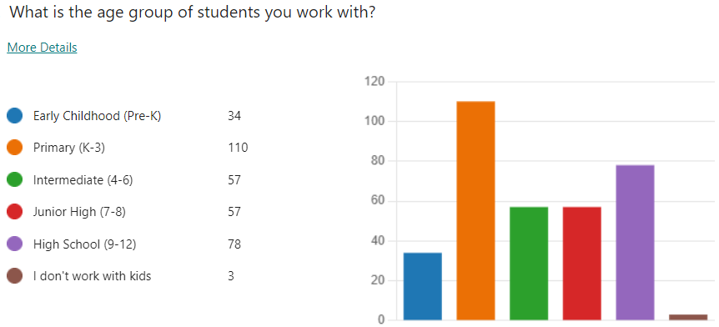
Who took it?

Slide 4
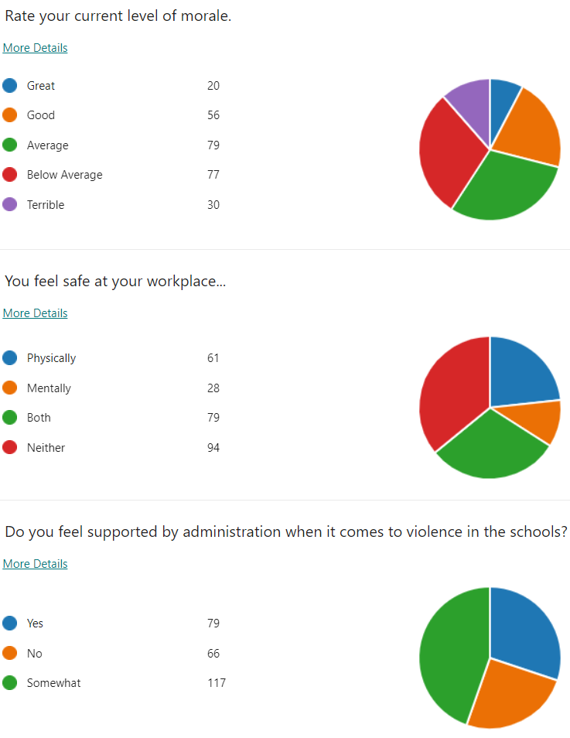
Morale, Safety, and Support

Slide 5
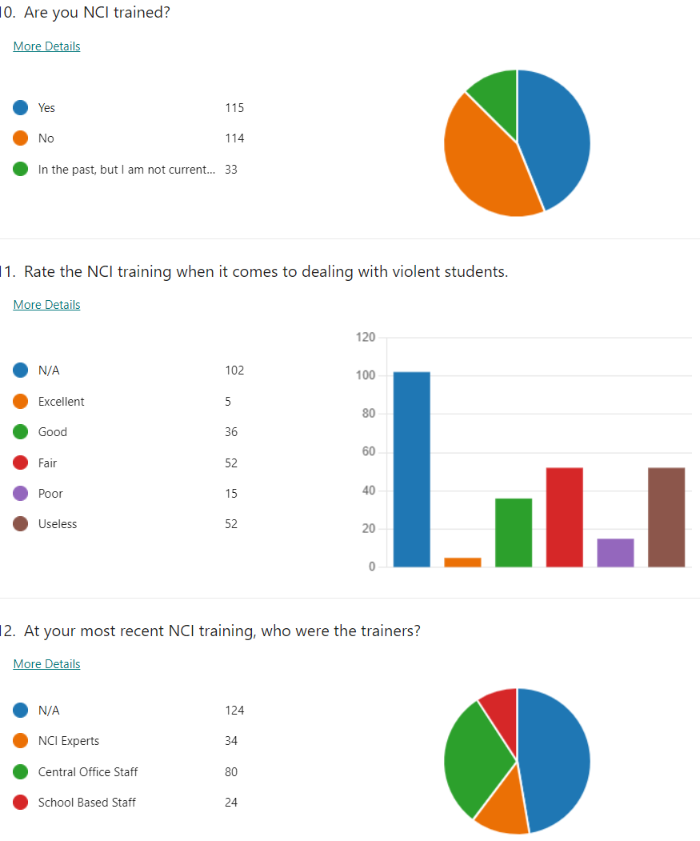
NCI Training

Slide 6
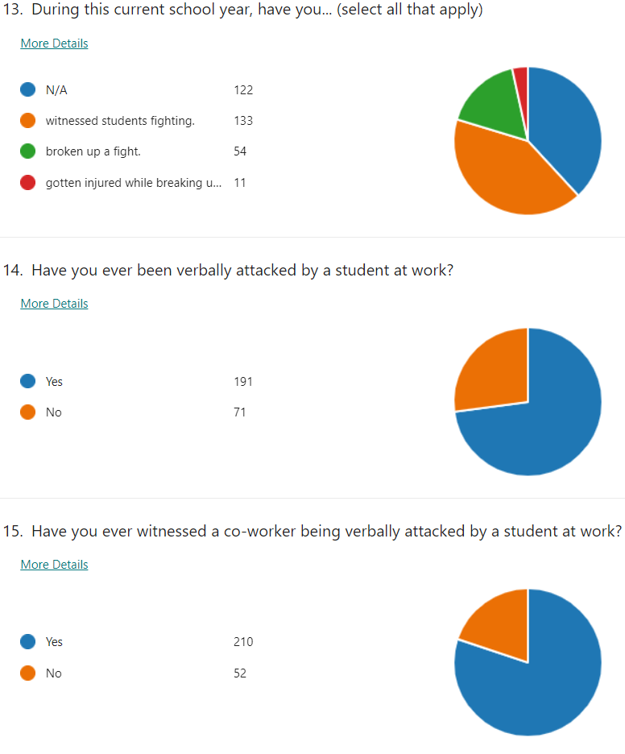
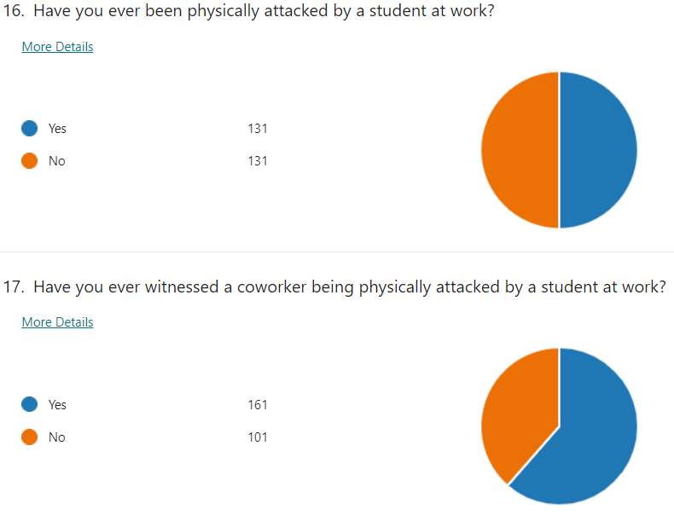

Slide 7
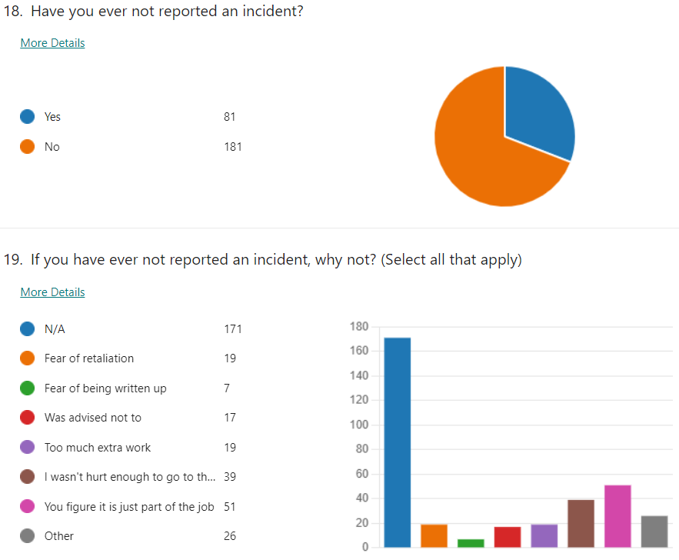

Slide 8
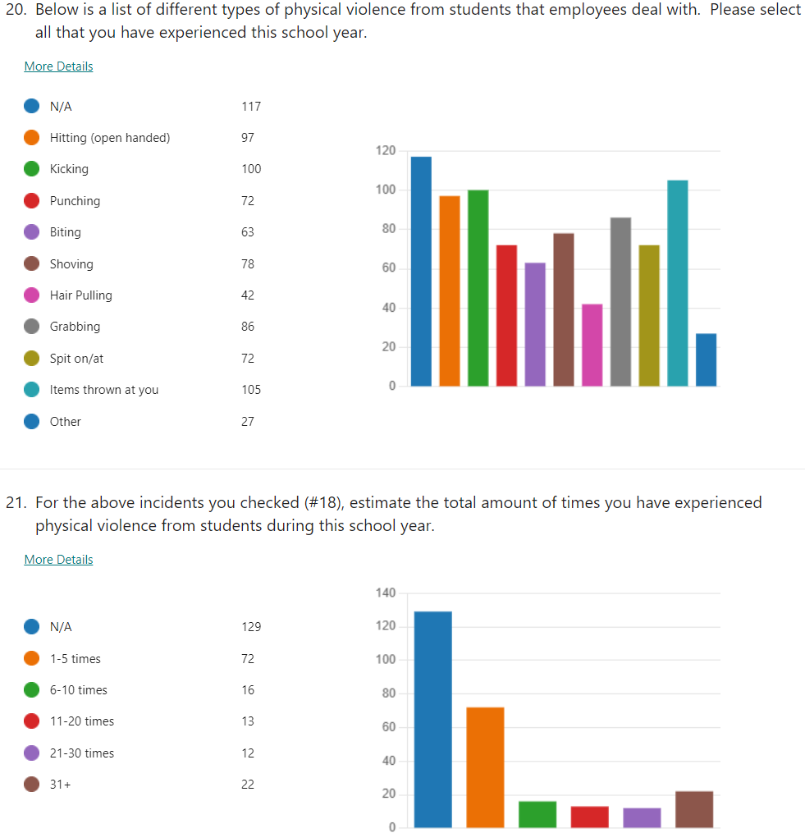

Slide 9
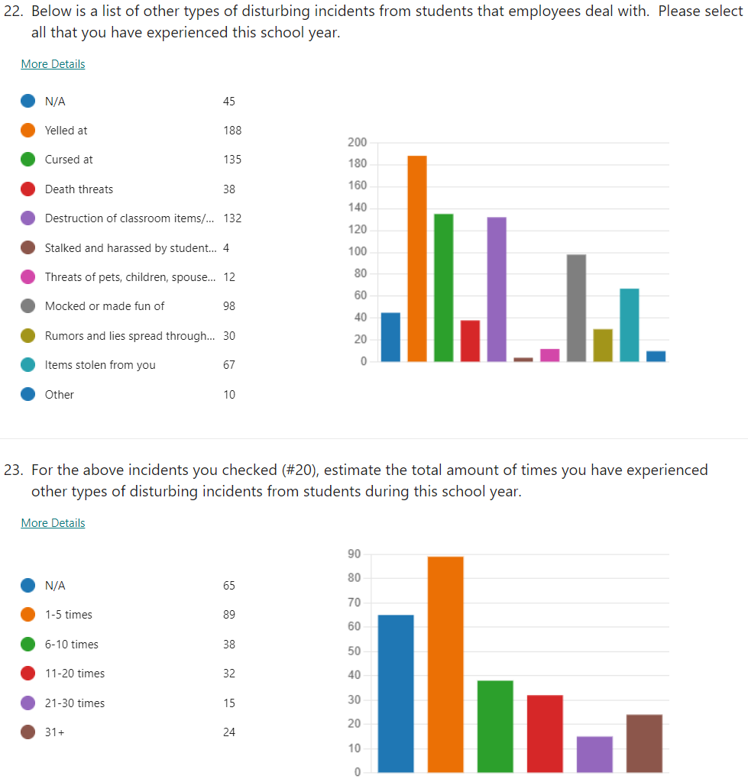

Slide 10
Some suggestions that can be implemented at the parish level…
Students receiving actual consequences that are clear, immediate, and appropriate, not sent back to class with a “reward.” (i.e. chips, candy, stickers, etc.)
Implementing a true alternative setting for students with extreme behaviors (verbal and/or physical).
Removal of student for more than 45 days.
A true zero tolerance policy resulting in expulsions.
Providing true mental health classes to students that are violent and/or emotionally disturbed—they need more help than the traditional setting can offer.
Administrators supporting the staff more.
Administrators being supported by central office staff.
Add mental health and behavioral schools to our system.
Consistency with discipline.
Allow paras to do write-ups/give consequences; give more authority.
Educated parents about employee and other students’ rights to a safe and appropriate environment/education.
Put the well-being of students and employees first and truly expel the violent students.
Educate students and teachers on trauma, triggers, empathy, coping mechanisms, etc.
Hold parents accountable with mandatory parental involvement for those that have issues, payment for damages, and shadowing students at school.
Listen to those that work with the violent students on a daily basis.
Have clear, unified consequences and don’t worry about the numbers.
Educate employees on how to get to know their students and triggers.
More staff and smaller classes.
Implement a curricular-based class into the school day like PE to teach social interactions, behavior skills, coping skills, etc.
Give hazard pay to employees who deal with these students.
Believe employees when they report incidents.

